Slide 1
The Attributable Outcome of Urban Deprivation on Hypertension in Children in England: A Clustering and Propensity Analysis
Xueming Ma
Institute of Epidemiology & Health
28th November 2018

Slide 2
Chapter I: INTRODUCTION
Chapter II: LITERATURE REVIEW
Chapter III. METHOD
Chapter IV. RESULTS
Chapter V. DISCUSSION

Slide 3
Significance of the Problem -- Why is hypertension an issue?
Hypertension - key hurdles for children’s health in England
Emotional and Behavioural
Many children experiencing bullying linked to their health status.
Hypertensive children are more likely to prevalent hypertension during adulthood.
School Absence
More than 1 in 5 children are overweight or obese when they begin school.
Almost 1 in 3 children are overweight or obese by the time they leave primary school.
Majority of hurdles are directly or indirectly linked to urbanisation and can be addressed through advocacy effort.
High cholesterol
Pre-diabetes
Bone & joint problems
Breathing difficulties
Increased risk of becoming overweight adults
Life course models.
Risk of ill-health and premature mortality in adult life.
SOURCE: https://www.gov.uk/government/publications/childhood-obesity-applying-all-our-health/childhood-obesity-applying-all-our-health

Slide 4
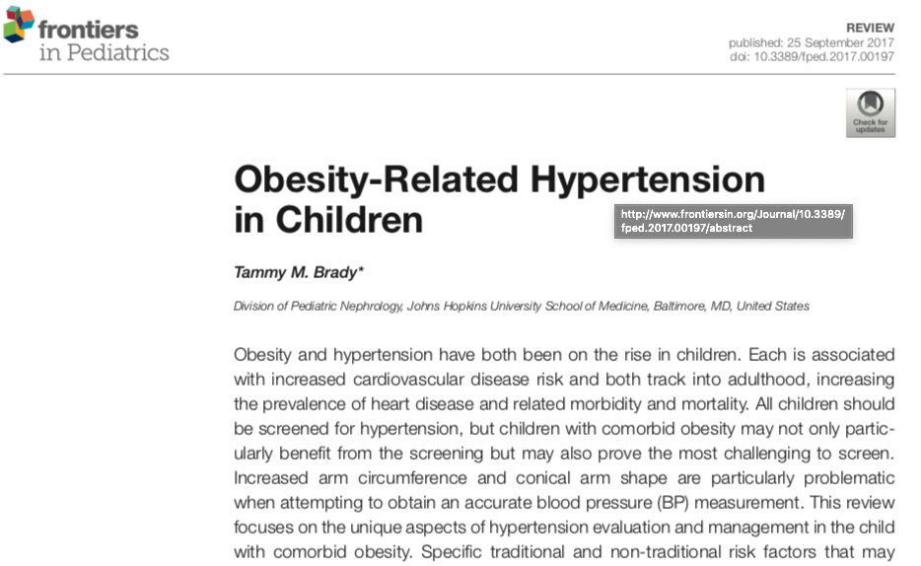
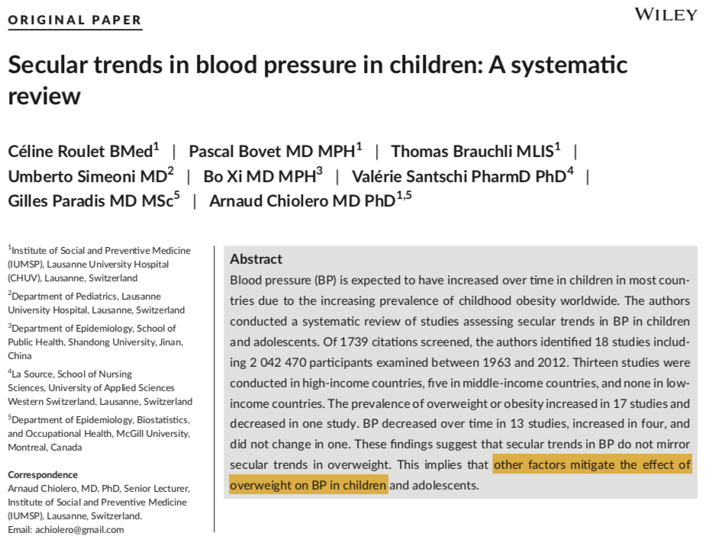
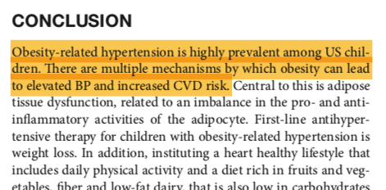
Importance to conduct the study

Slide 5
Chapter I: INTRODUCTION
Chapter II: LITERATURE REVIEW
Chapter III. METHOD
Chapter IV. RESULTS
Chapter V. DISCUSSION

Slide 6
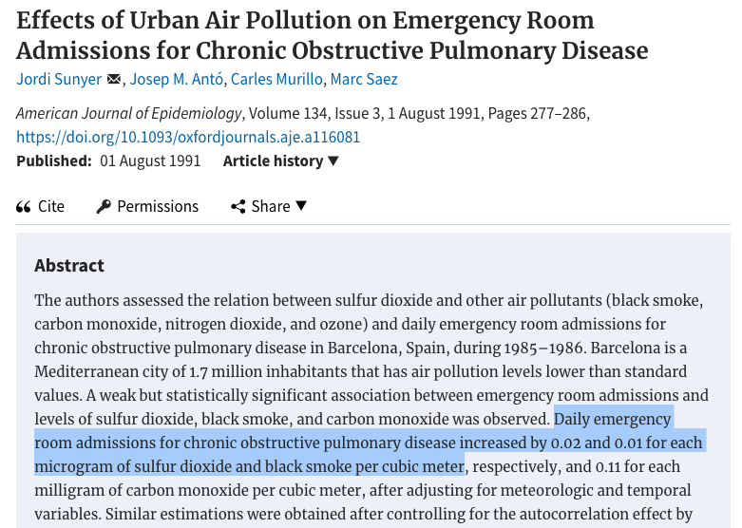
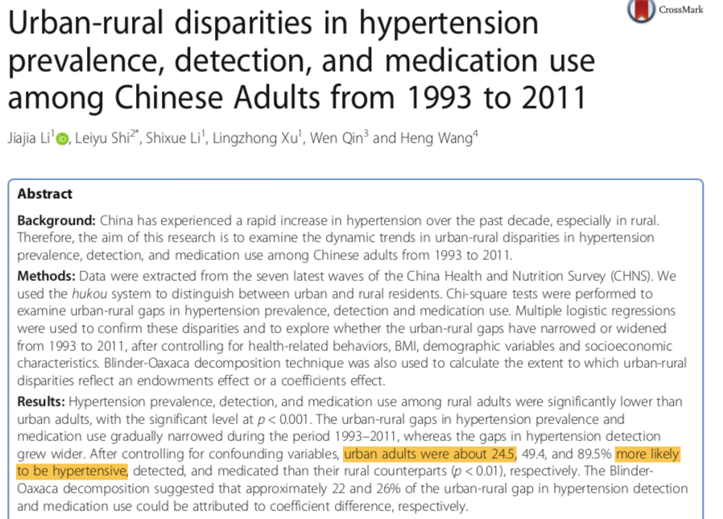
Historical Background

Slide 7

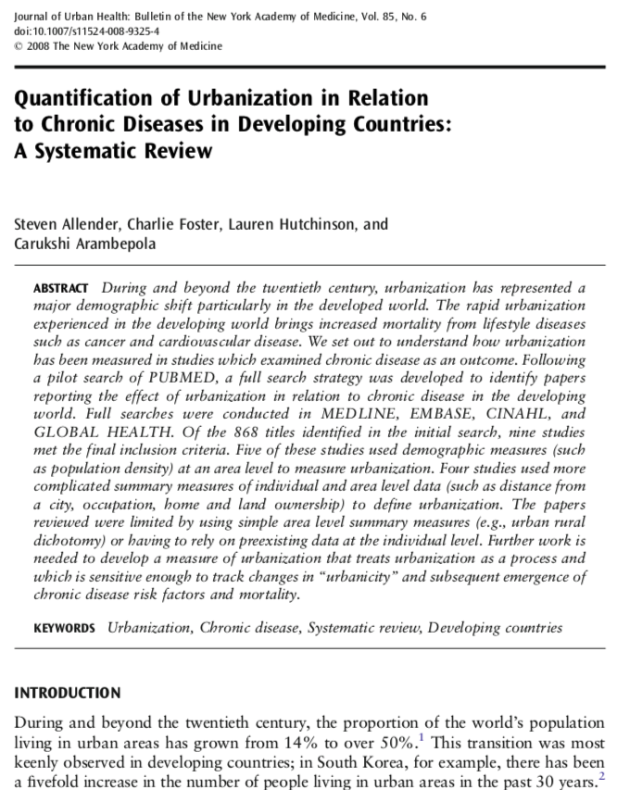
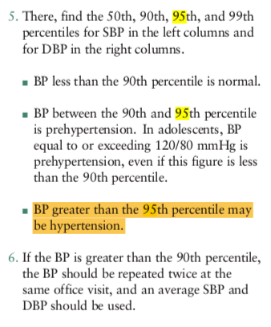
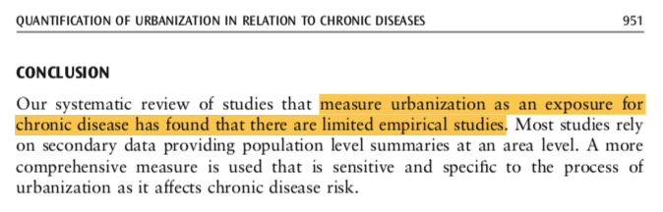
Theory and Literature Relevant to Research Hypotheses

Slide 8
Chapter I: INTRODUCTION
Chapter II: LITERATURE REVIEW
Chapter III. METHOD
Chapter IV. RESULTS
Chapter V. DISCUSSION

Slide 9

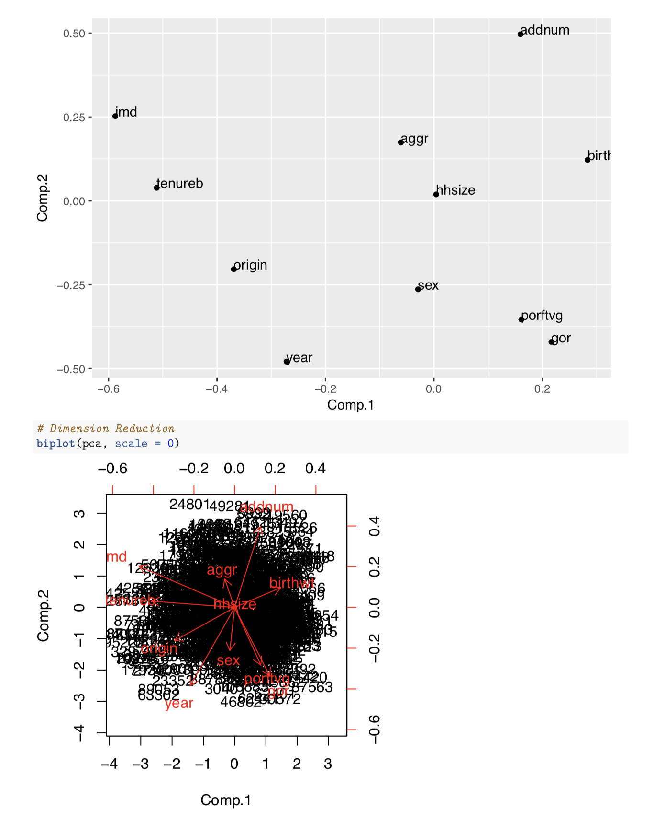
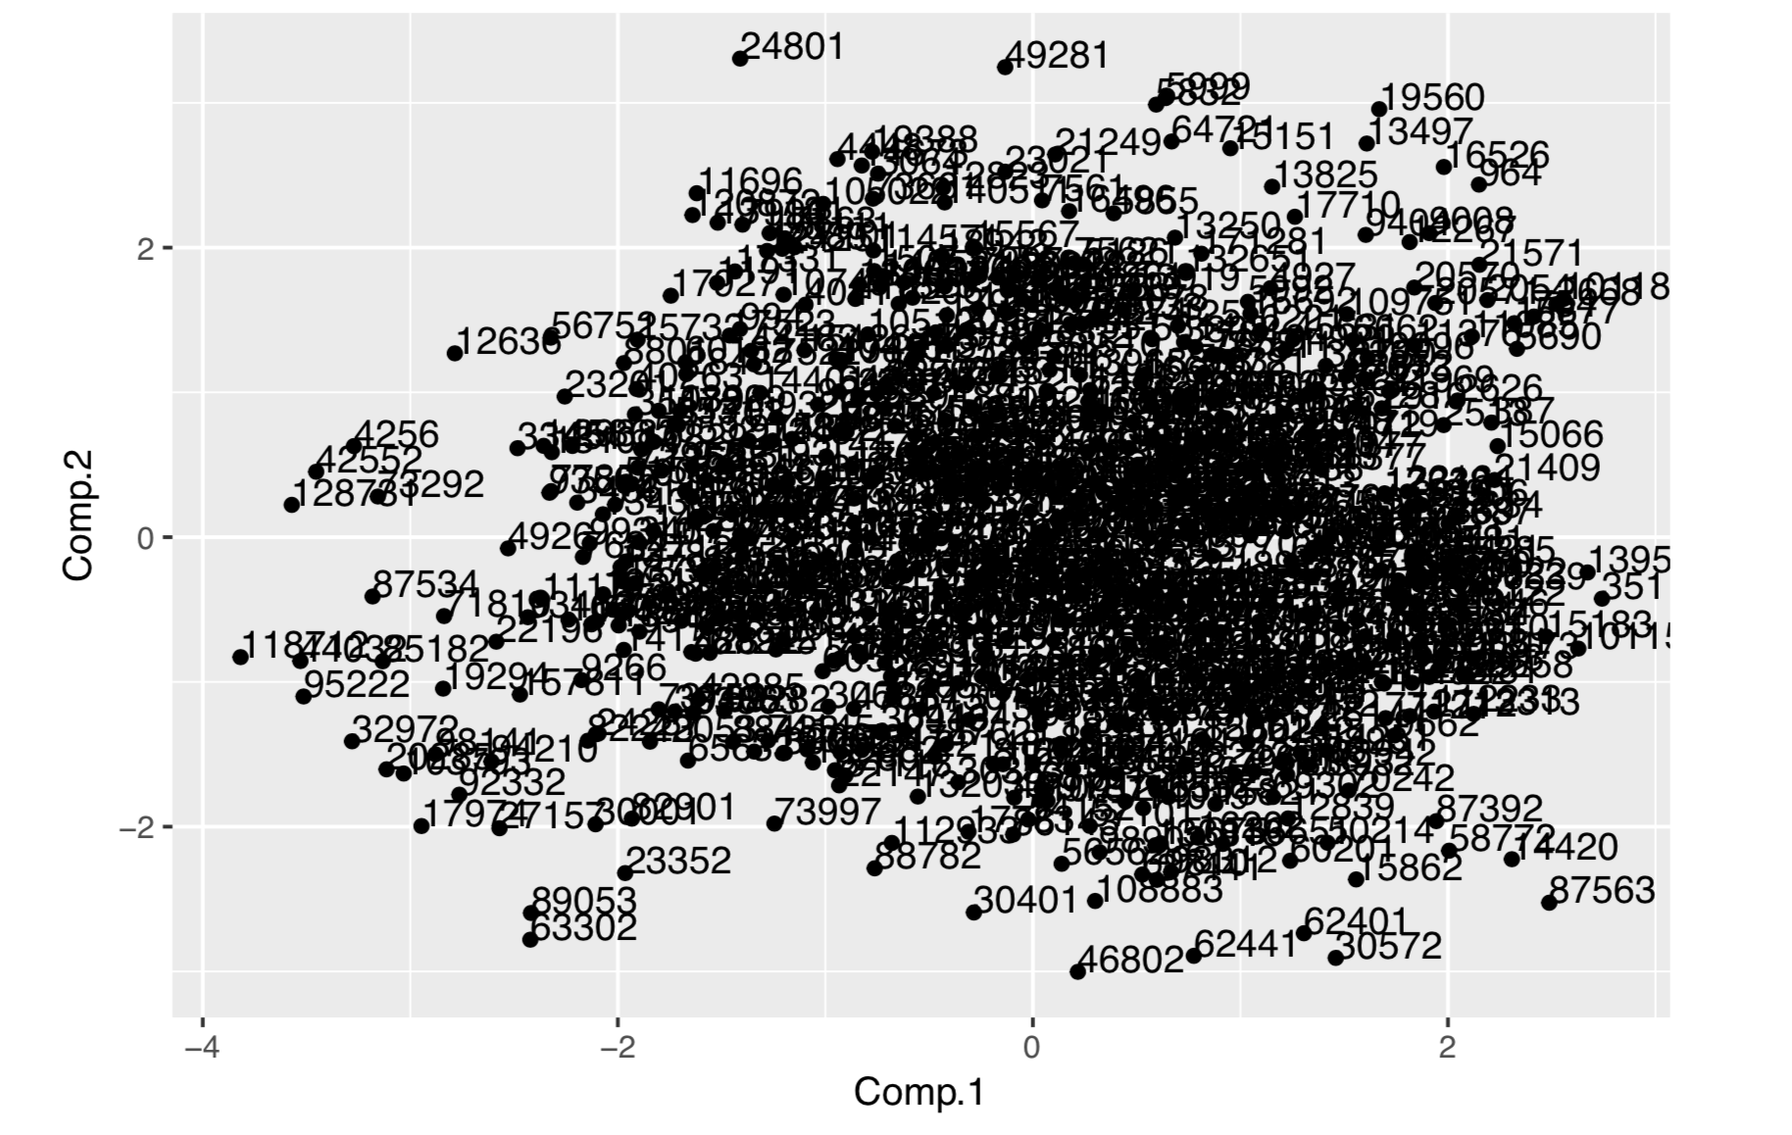
A Clustering Analysis

Slide 10
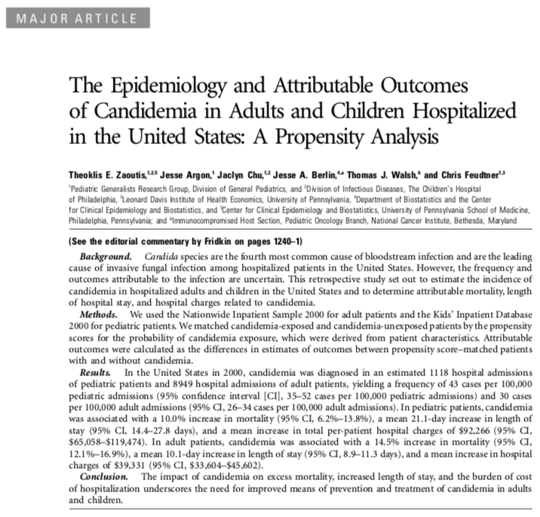
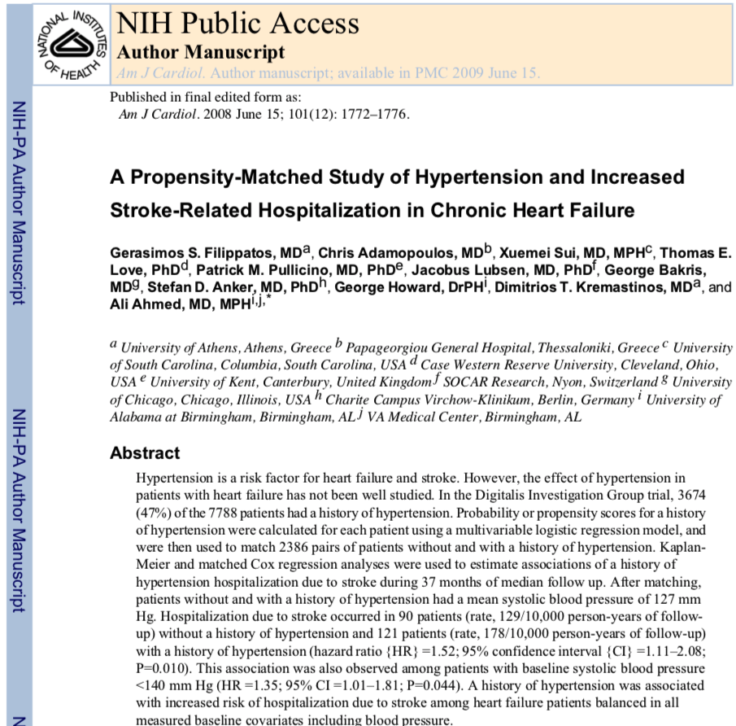
A Propensity Analysis

Slide 11
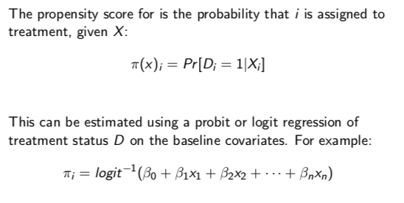
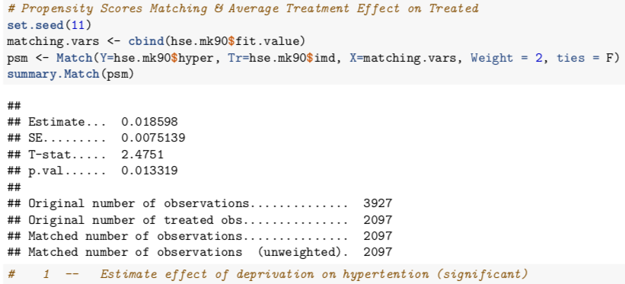

Slide 12
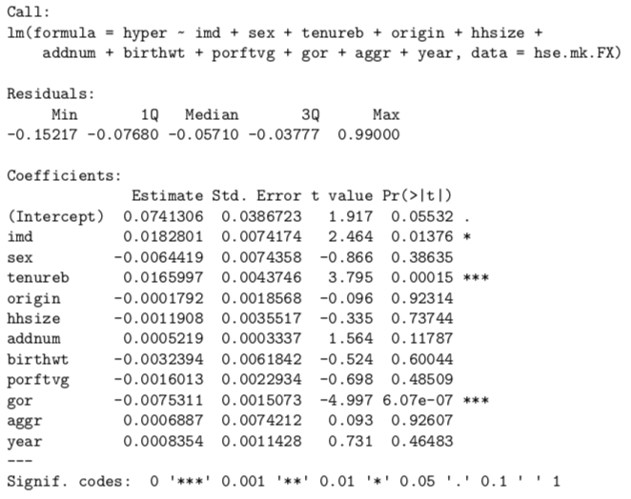

Slide 13
References
Allender, S., Foster, C., Hutchinson, L. & Arambepola, C. (2008) Quantification of urbanization in relation to chronic diseases in developing countries: a systematic review. Journal of Urban Health: Bulletin of the New York Academy of Medicine.
Baker-Smith, C.M., Flinn, S.K., Flynn, J.T., Kaelber, D.C., et al. (2018) Diagnosis, Evaluation, and Management of High Blood Pressure in Children and Adolescents. Pediatrics.
Brady, T.M. (2017) Obesity-Related Hypertension in Children. Frontiers in Pediatrics.
Filippatos, G.S., Adamopoulos, C., Sui, X., Love, T.E., et al. (2008) A Propensity-Matched Study of Hypertension and Increased Stroke-Related Hospitalization in Chronic Heart Failure. The American journal of cardiology.
Guo, Q., Lu, X., Gao, Y., Zhang, J., et al. (2017) Cluster analysis: a new approach for identification of underlying risk factors for coronary artery disease in essential hypertensive patients. Scientific Reports.
Li, J., Shi, L., Li, S., Xu, L., et al. (2017) Urban-rural disparities in hypertension prevalence, detection, and medication use among Chinese Adults from 1993 to 2011. International Journal for Equity in Health.
Roulet, C., Bovet, P., Brauchli, T., Simeoni, U., et al. (2017) Secular trends in blood pressure in children: A systematic review. Journal of Clinical Hypertension (Greenwich, Conn.).
Zaoutis, T.E., Argon, J., Chu, J., Berlin, J.A., et al. (2005) The epidemiology and attributable outcomes of candidemia in adults and children hospitalized in the United States: a propensity analysis. Clinical Infectious Diseases: An Official Publication of the Infectious Diseases Society of America.

Slide 14
The Attributable Outcome of Urban Deprivation on Hypertension in Children in England: A Clustering and Propensity Analysis
Xueming Ma
m.ma.16@ucl.ac.uk

